Slide 1
IMDb Challenge
By:Pradyumna YM PES1201700986
Rajath S PES1201701134
Harish P.B PES1201701435

Slide 2
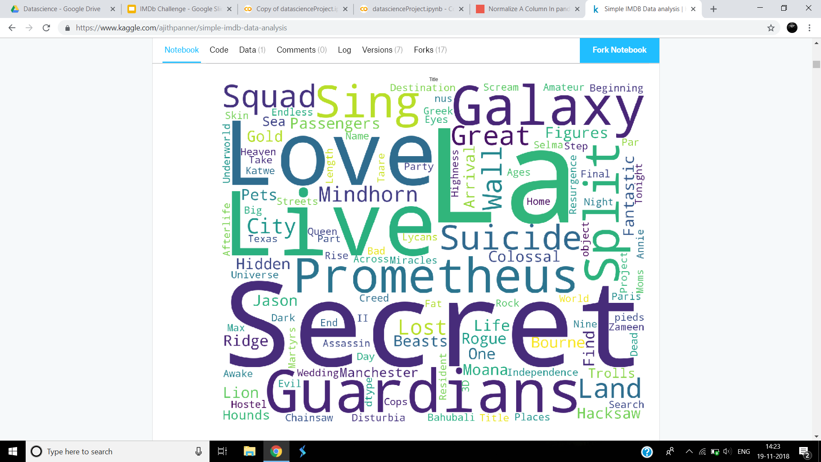

Slide 3
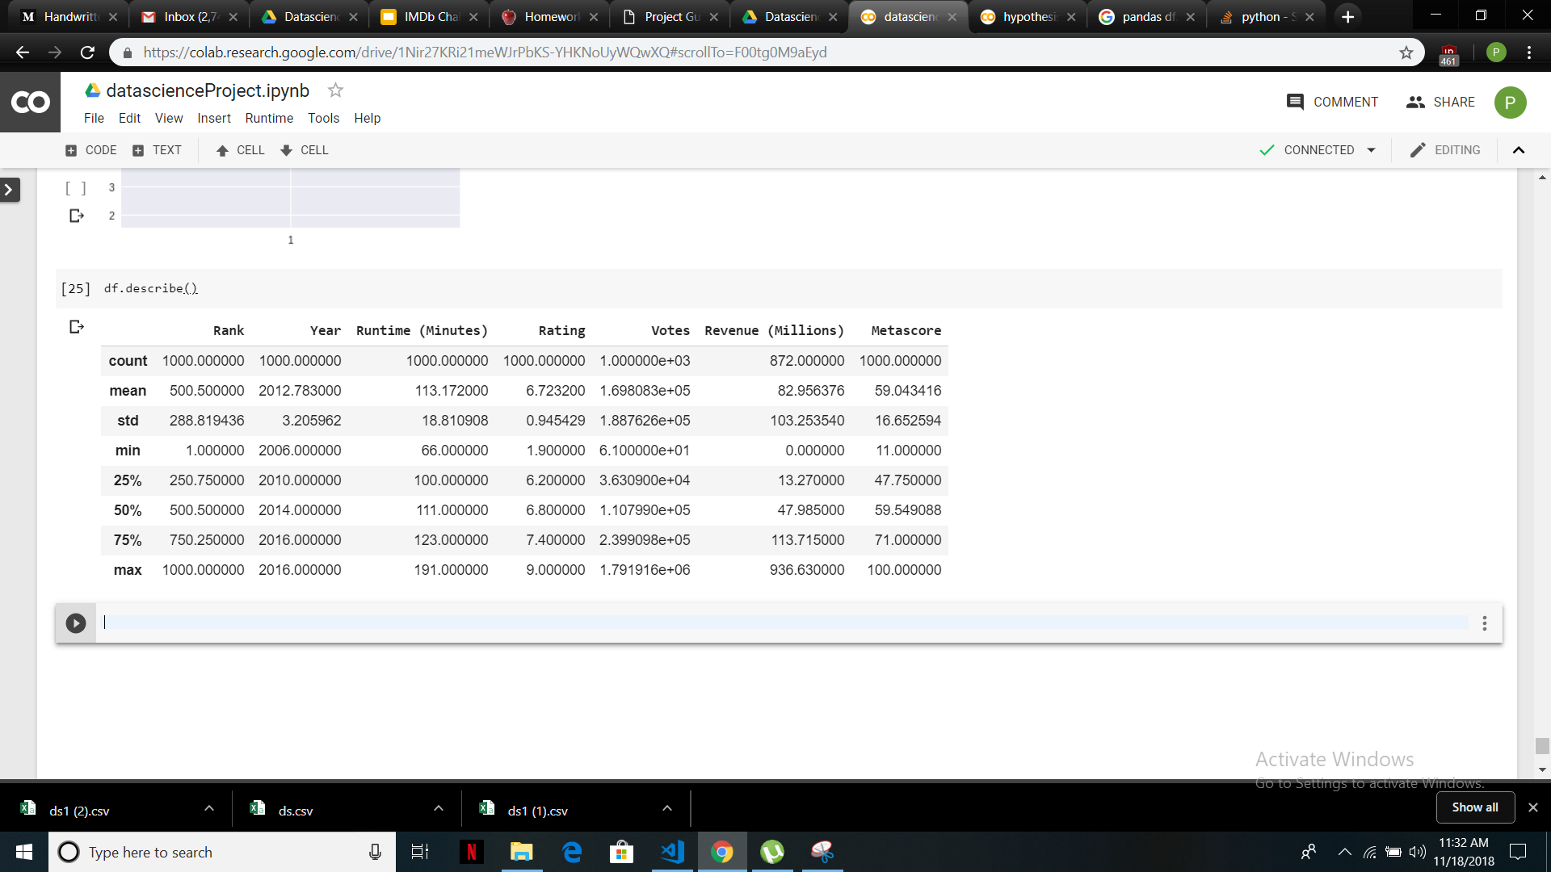
The Dataset
The Dataset contains 10 attributes for each data point.
There are about 1000 data points. Each data point is a Movie that has been released between the years 2006 and 2016.
There are 7 numerical attributes and 3 categorical columns.
We dropped the summary column because we couldn't generalize it

Slide 4
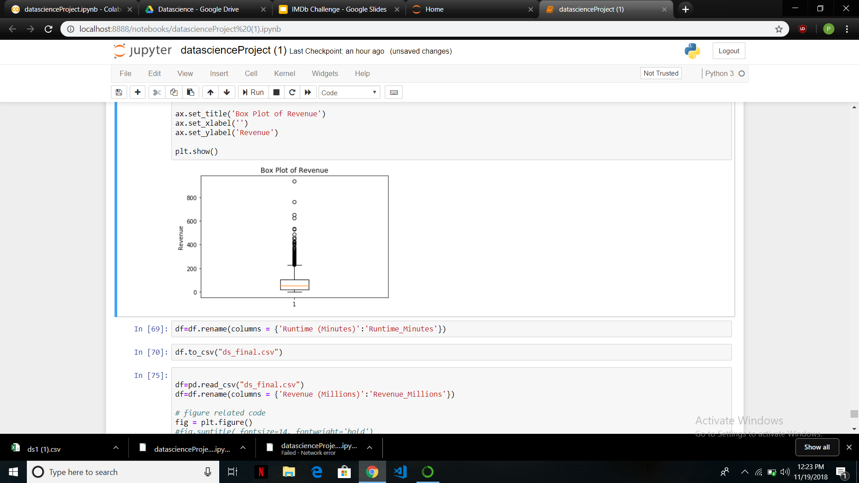
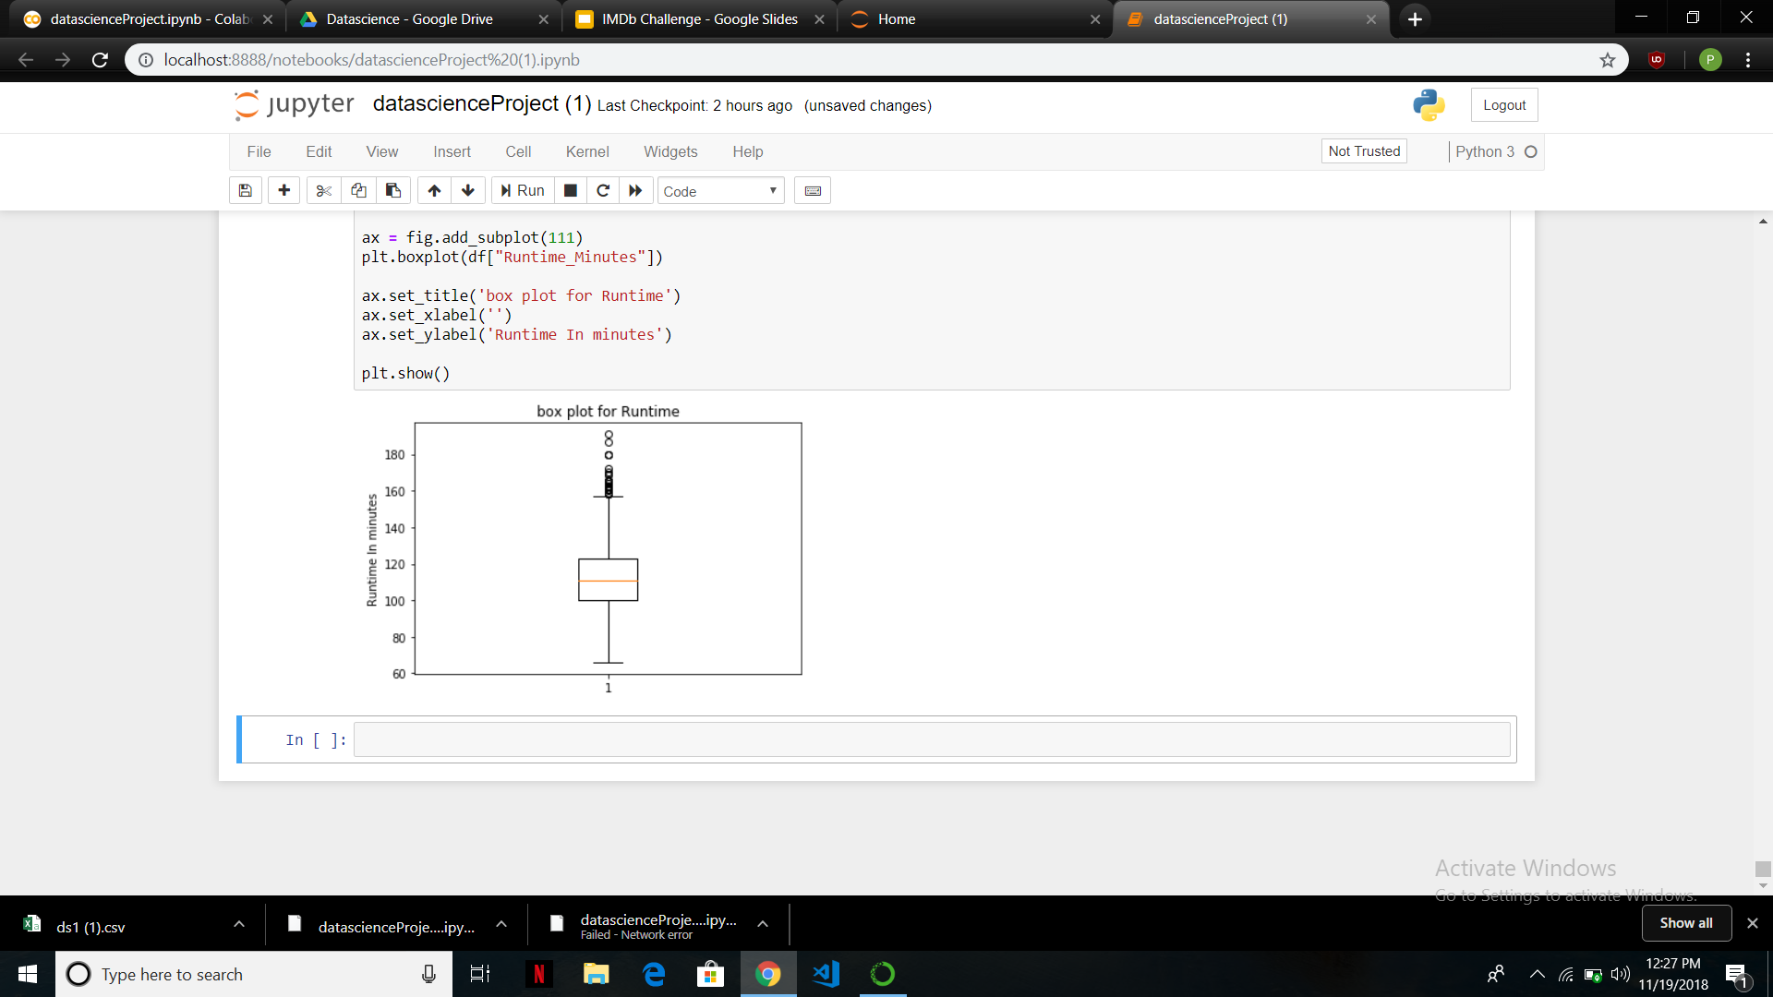
Box Plots
The Box plots show presence of outliers in both Revenue and Runtime.
We chose not to remove the outliers because the number of data points is small and since the outliers are not entry mistakes since the data has been taken from IMDb.

Slide 5
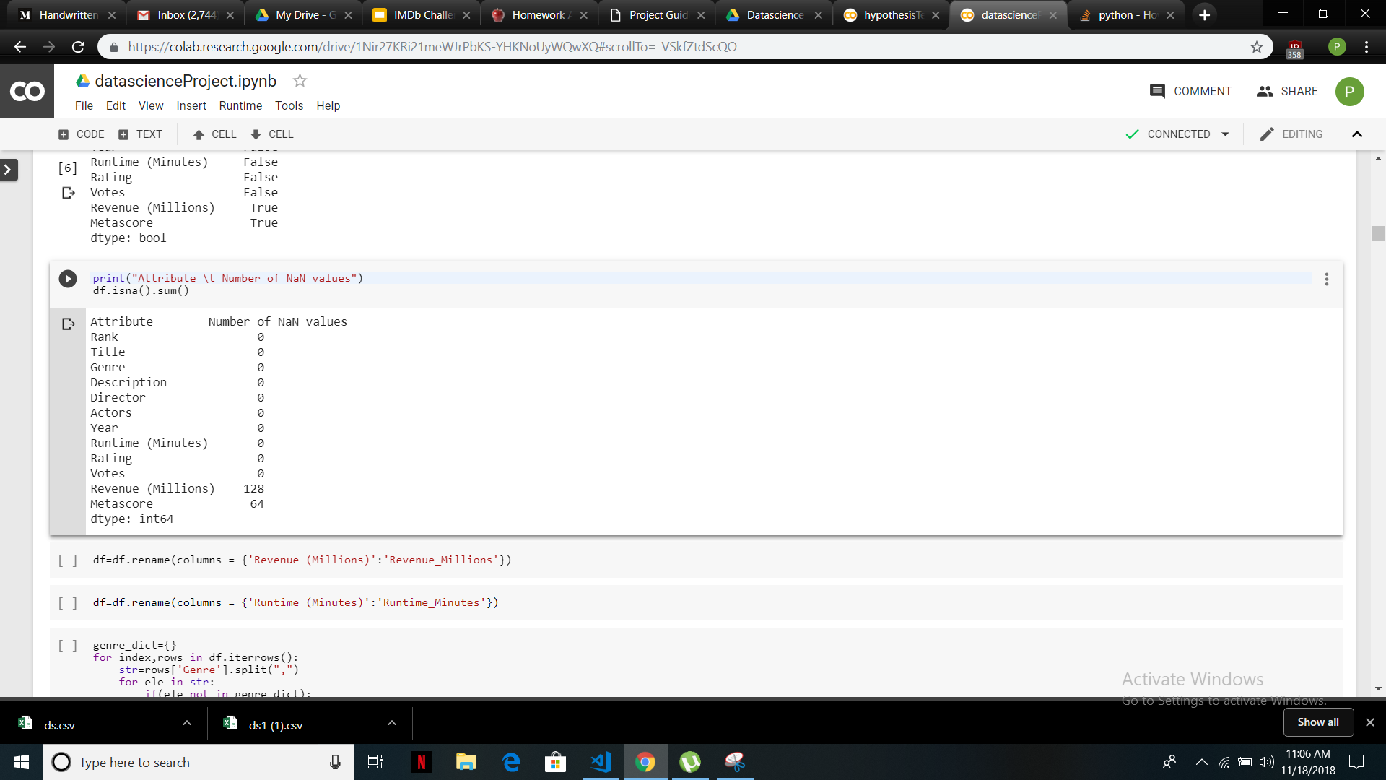
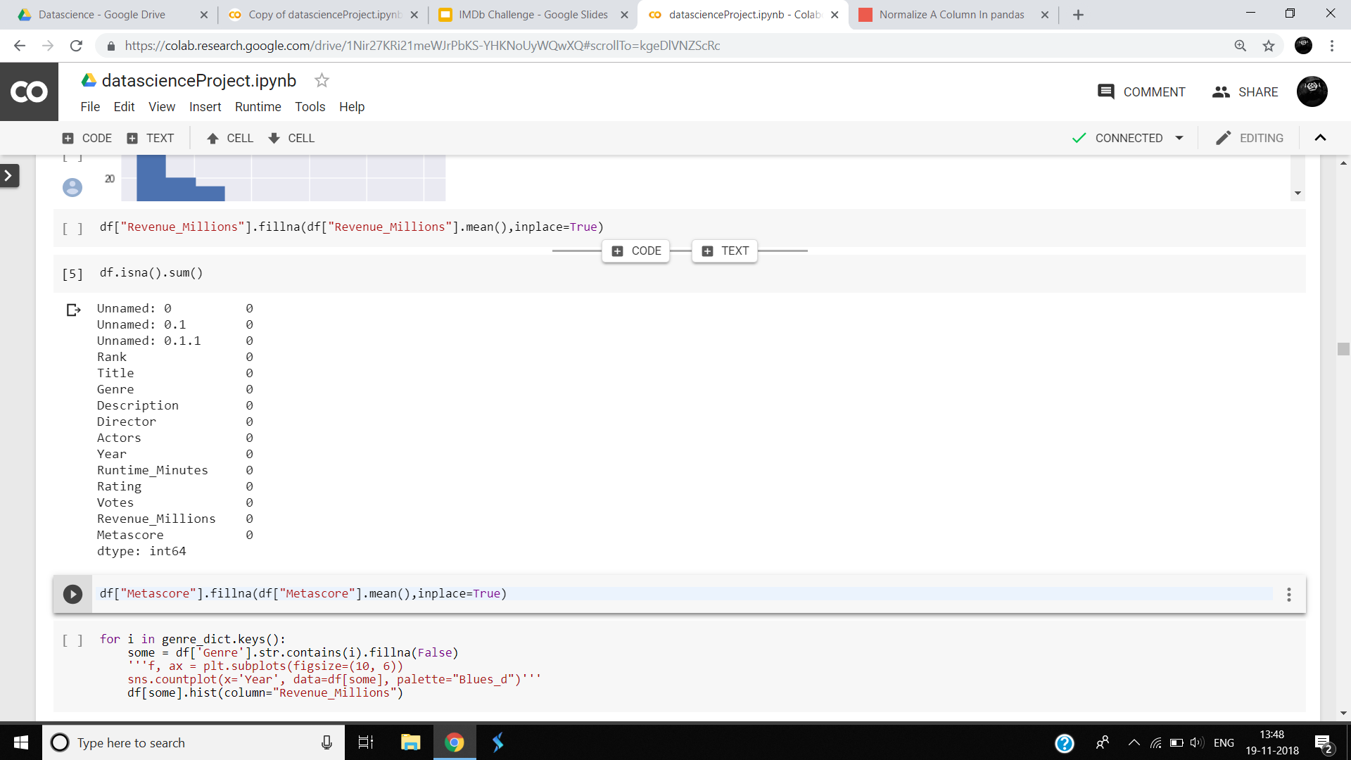
Data Cleaning
There were NaN values in 2 Numeric columns, MetaScore, and Revenue in Millions.
The Missing values have been replaced by the mean of the particular Genre it belongs to. For example, if the missing value is from Action, Drama genre, it has been replaced with the mean of the means of the two genres.
This way, All the added values will not be the same and hence, does not cause the dataset to be skewed on cleaning, since the mean of all of the movies is high because of the high number of action movies.
After cleaning
Before Cleaning

Slide 6
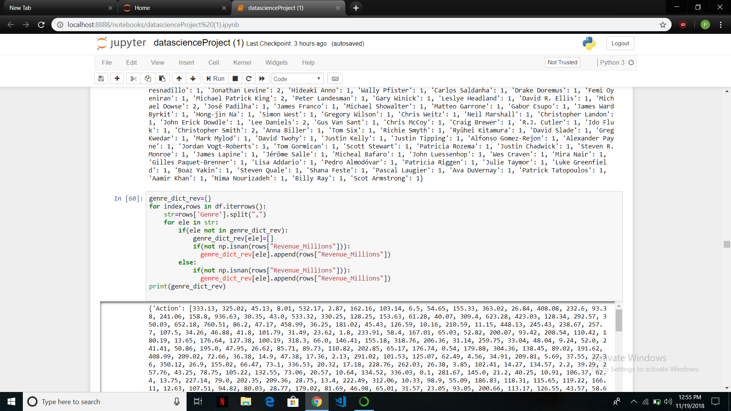
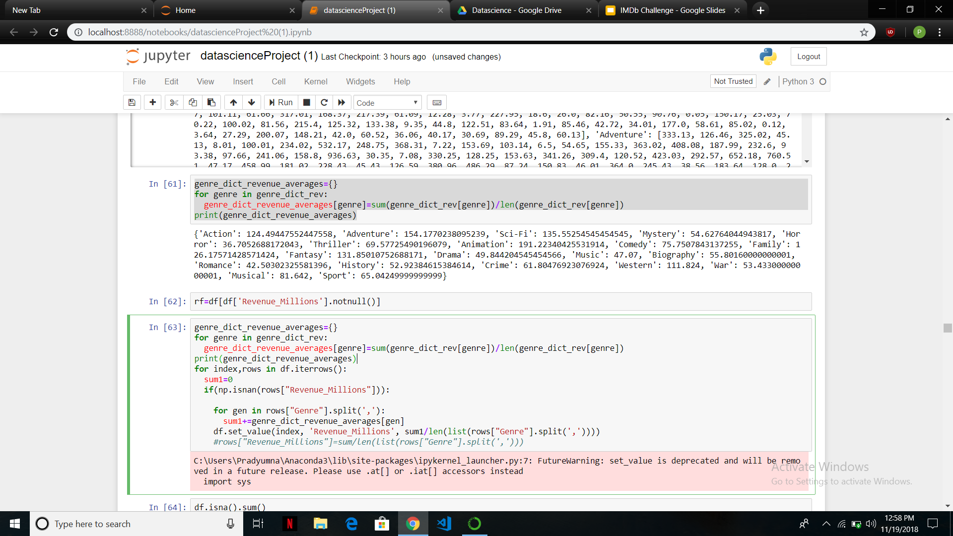
Code Snippet For Cleaning

Slide 7
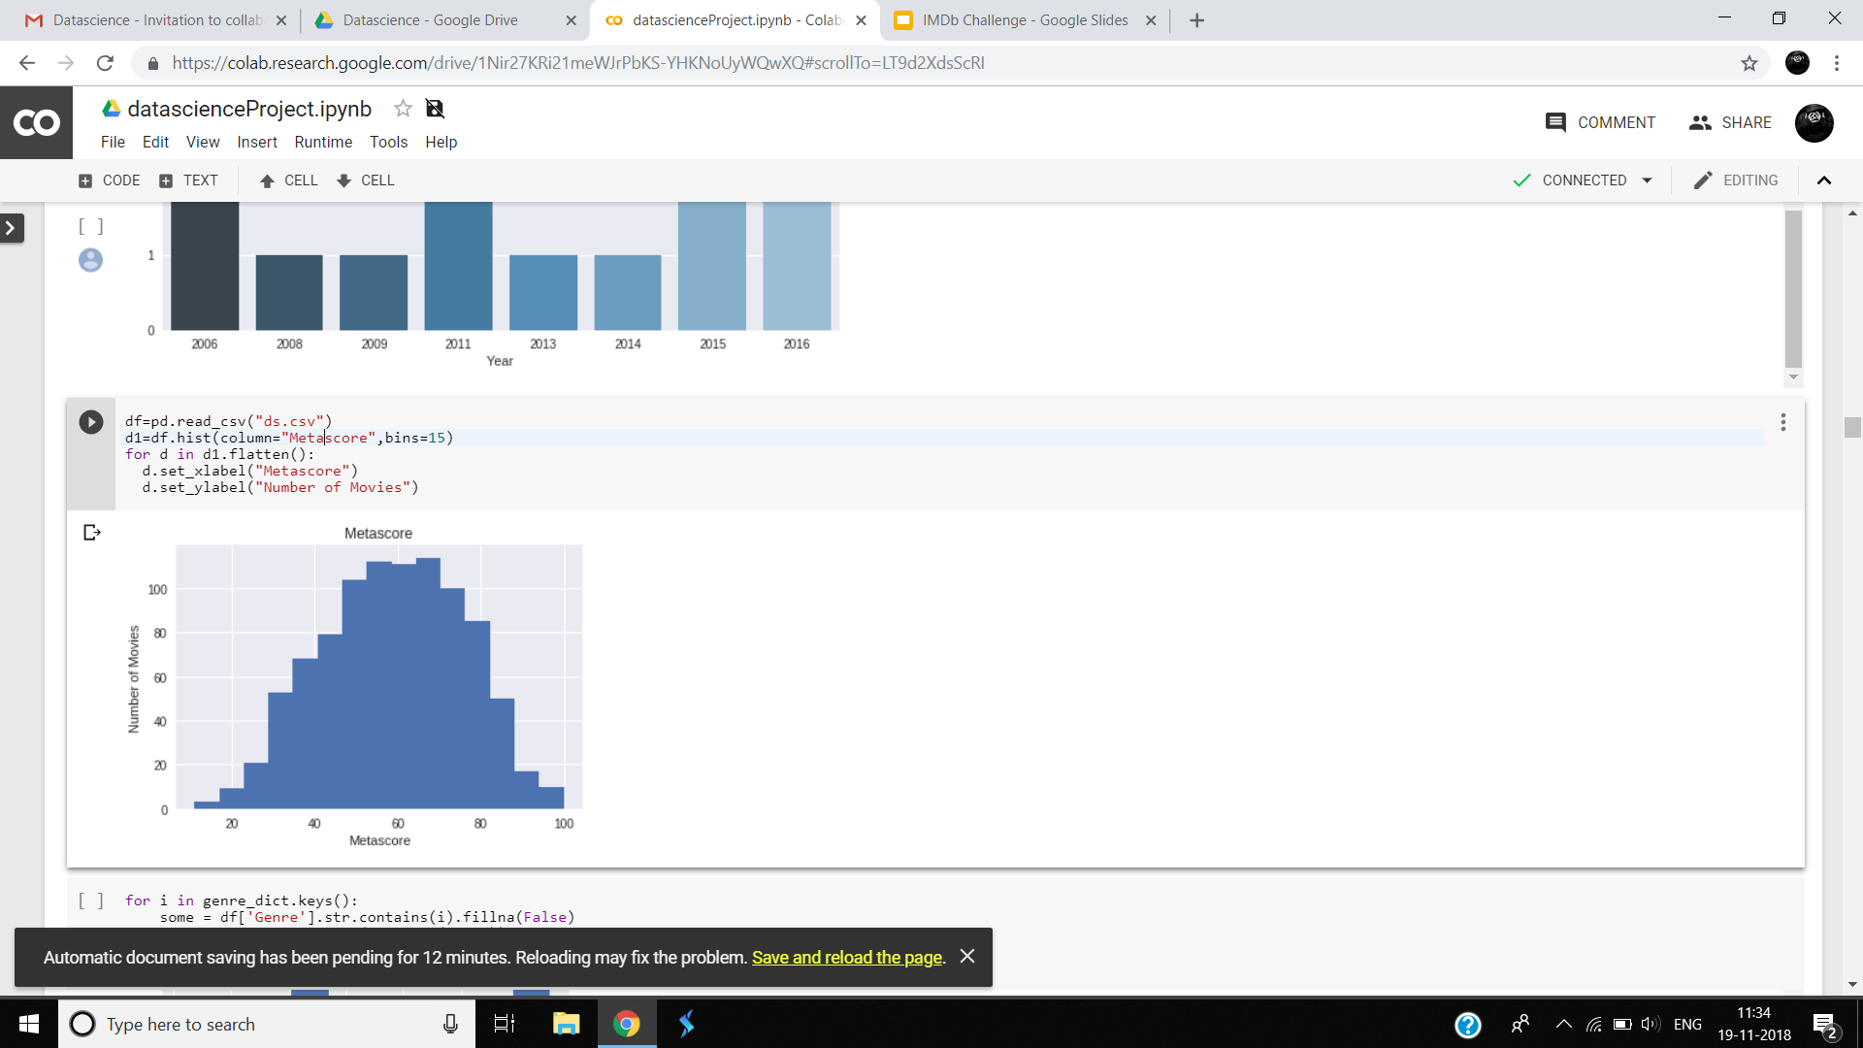
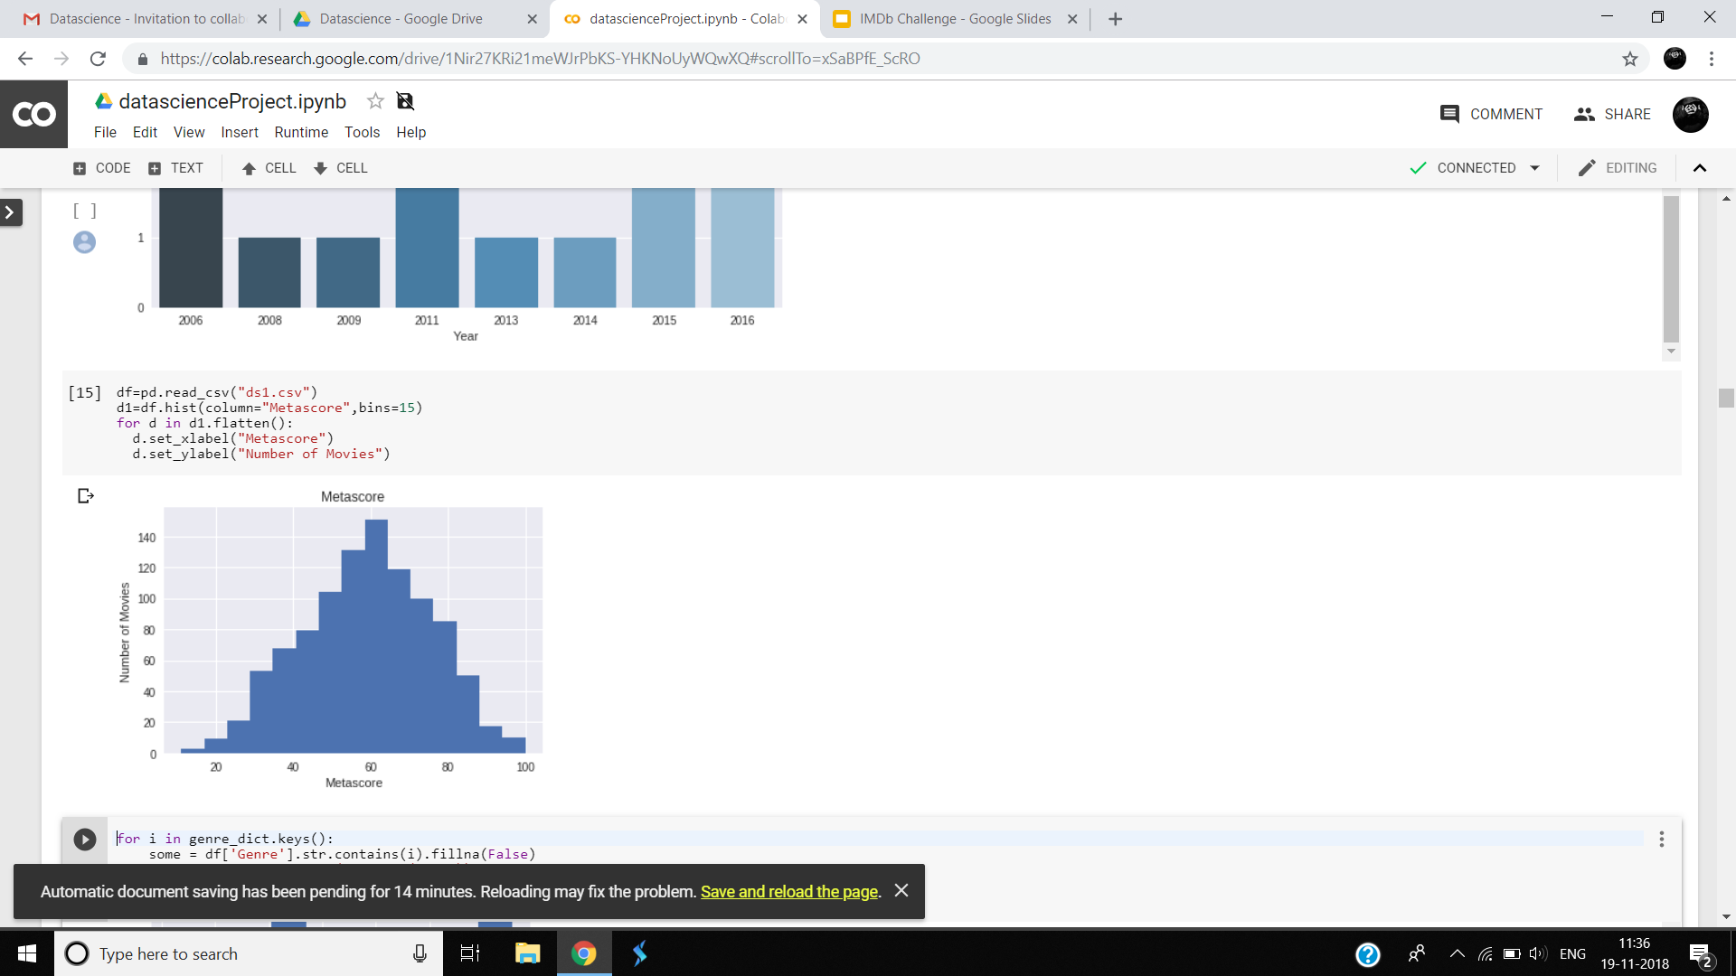
Results of Data Cleaning
Before Cleaning
After Cleaning
A Histogram can be used to determine the distribution of the Metascores before and after cleaning the data.
We see that the values have become more normal and a little less skewed after cleaning the data.
The revenue attribute also becomes more normal on cleaning the data.

Slide 8
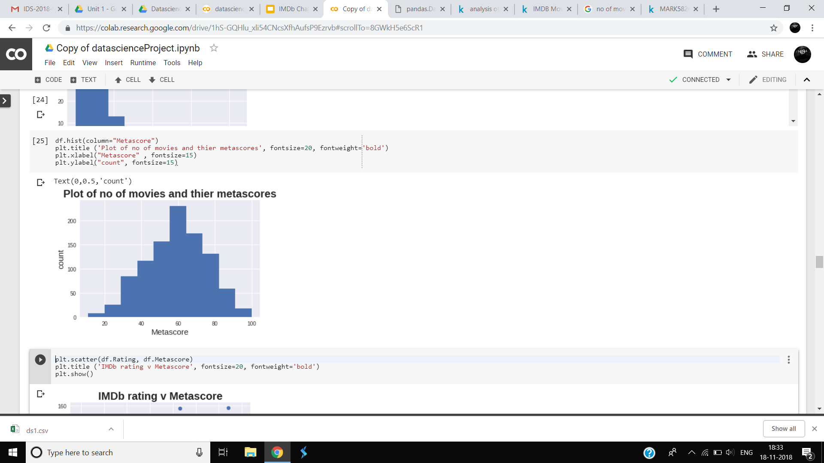
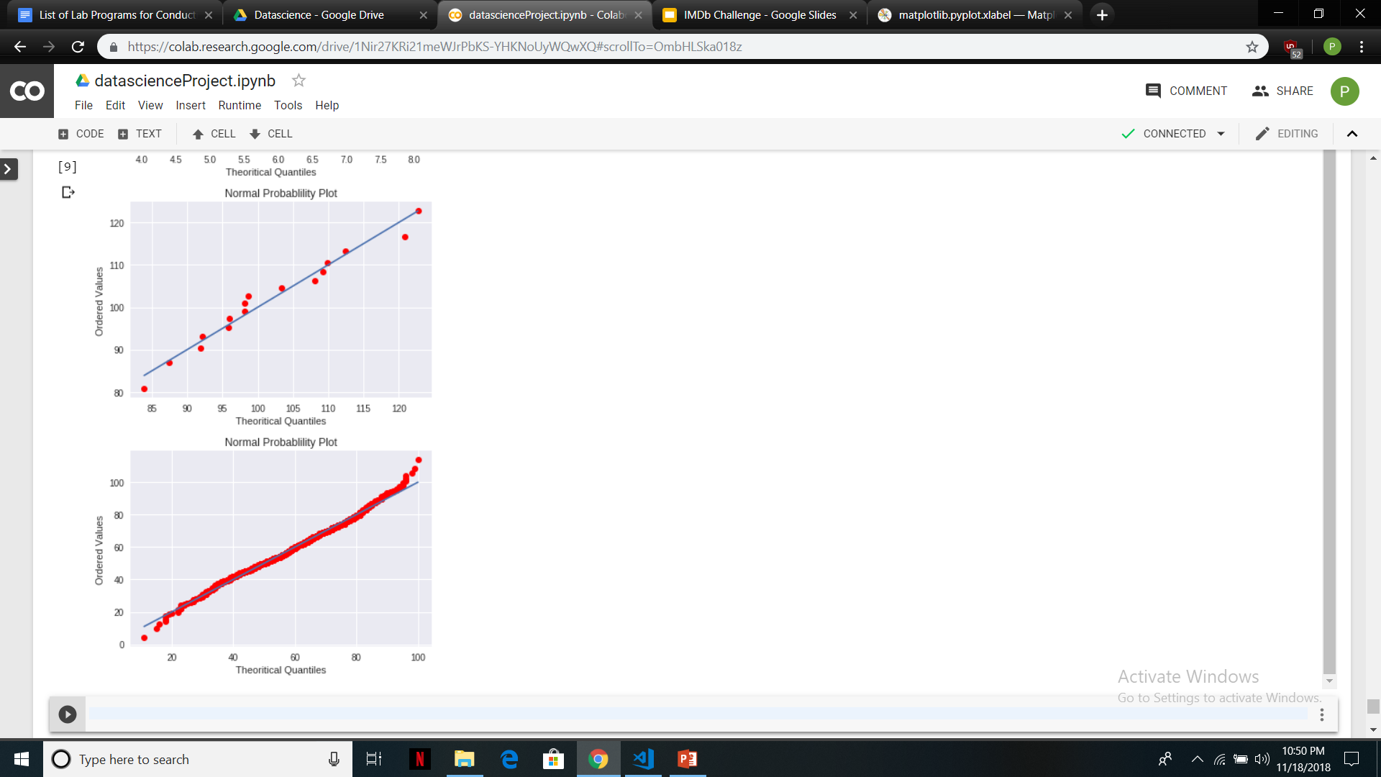
Normality of Metascore
Histogram is used to plot distributions of different variables , the above histogram displays the distribution of metascore
We can see that metascore follows approximately a normal distribution with mean at around 60.
This can also be confirmed, from the normal probability plot above.

Slide 9
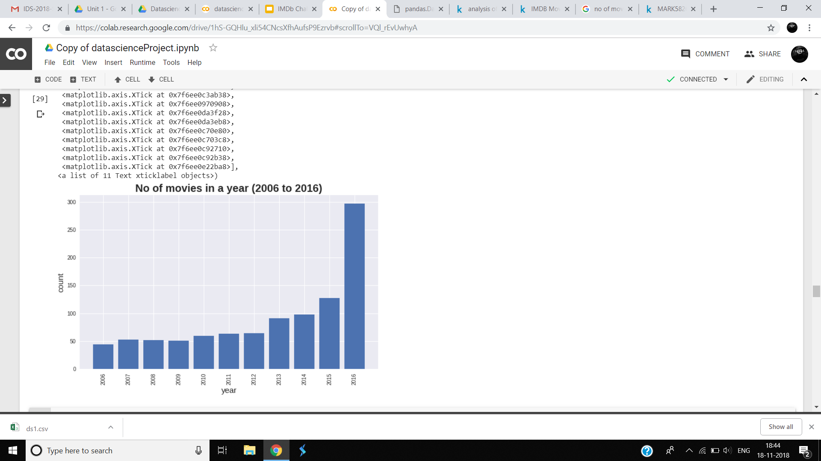
Data Visualisation
The above bar graph displays the number of movies every year
We see that the number of movies produced increases every year and towards 2016, an exponential growth can be seen, which tells us that the industry has been thriving lately.

Slide 10
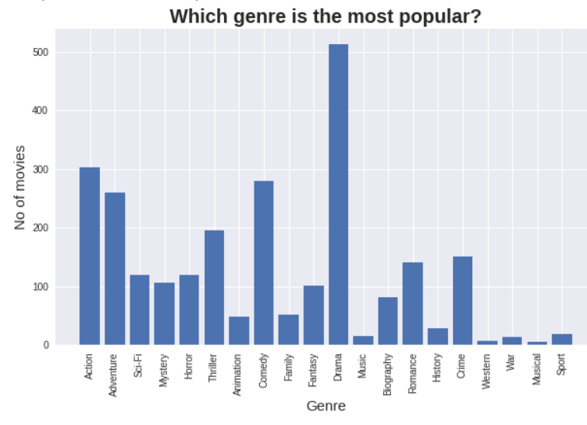
The above bar graph shows us the different genres the movies belong to.
We can see that drama movies are the most popular among all, followed by action and comedy movies.

Slide 11
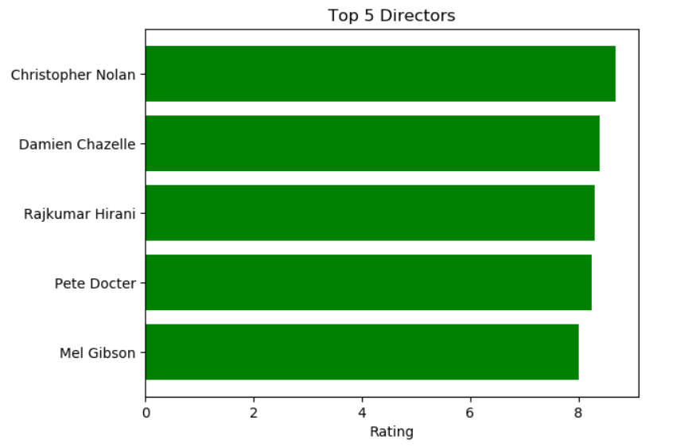
Top 5 Directors Based on Rating
These are the top 5 directors from 2006 to 2016 based on the ratings of the movies they have directed. To make the ratings consistent, we have considered directors who have directed at least two movies.

Slide 12
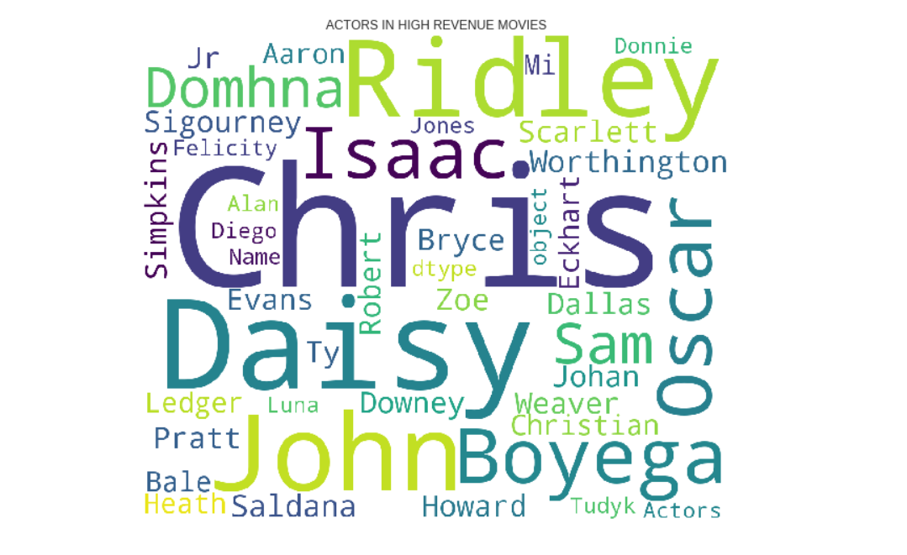
Actors in top revenue movies

Slide 13
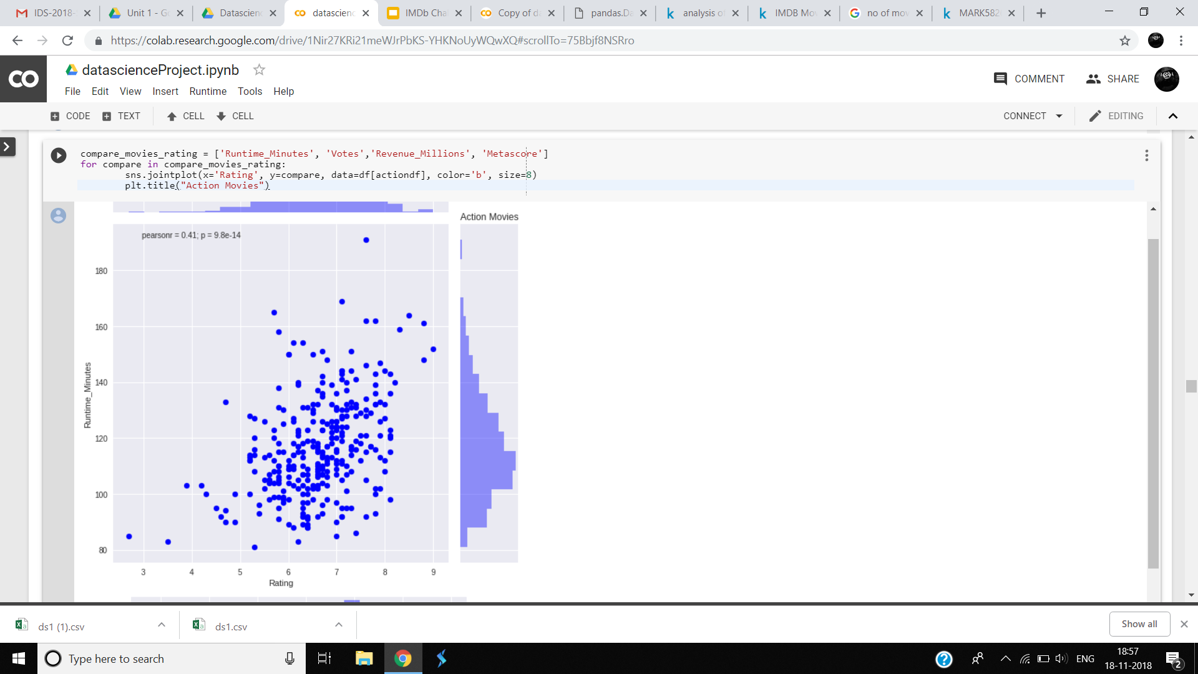
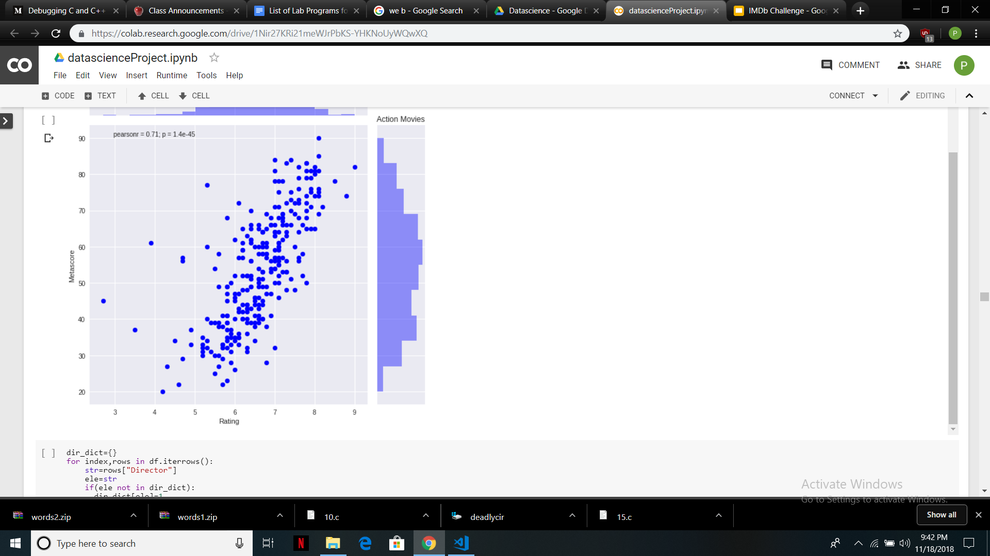
From this scatterplot, we can clearly see that there is not much correlation between the runtime and the rating of a movie. This tells us that there are movies with long runtimes which have been successful and there are short movies that have not been liked much.
From this scatterplot, we can clearly see that the metascores and ratings are positively related, that is , we can say that they are unbiased, and a good metascore implies a good rating.

Slide 14
Hypothesis Testing
Null Hypothesis: The average rating of movies is greater than or equal to 6.9.
Alternate hypothesis : The average rating of movies is lesser than 6.9
Data: Population standard deviation= 0.945 , sample size=100
Significance Level= 5 percent (alpha=0.05) ,
Critical z score= - 1.96
In our random sample, we obtain sample mean to be equal to 6.687
We obtain P-value to be equal to 0.012, and the z score corresponding to this P-value is equal to -2.2529.

Slide 15
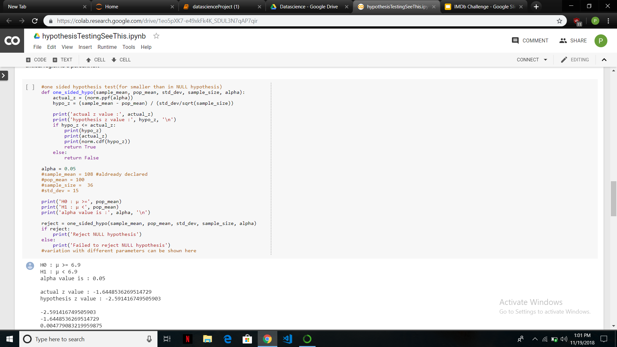
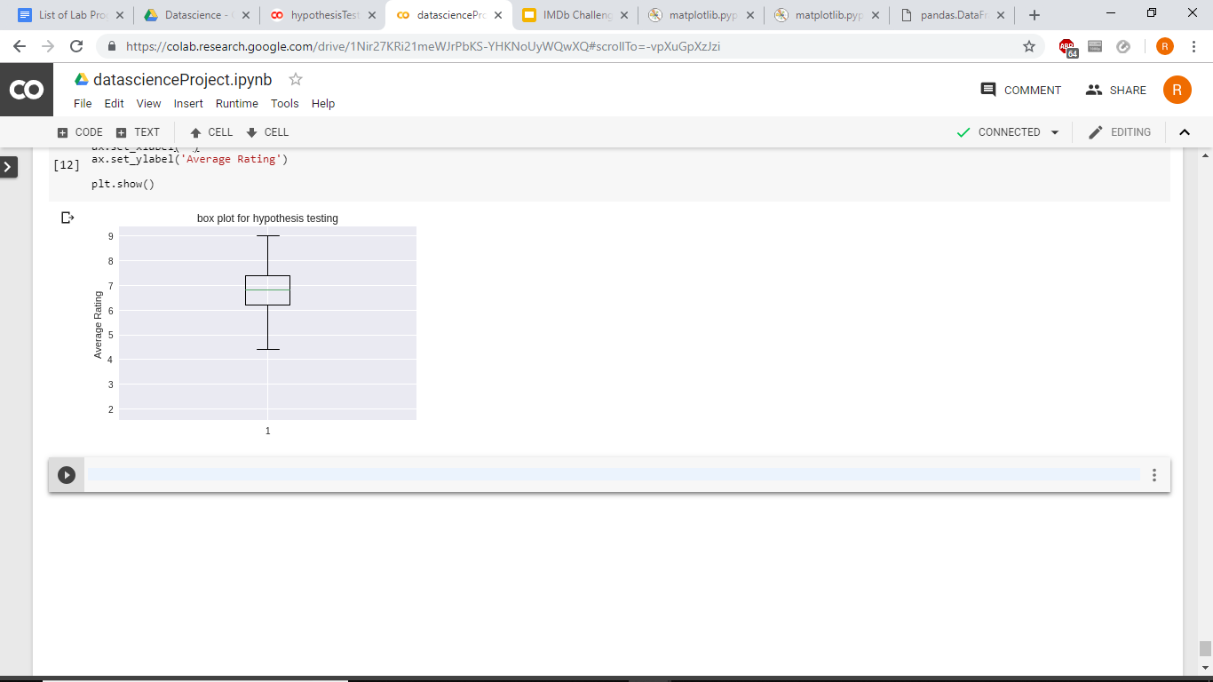
Conclusion:
As 0.012<0.05 (P-value less than our significance level),we can reject our Null Hypothesis.
We also observe that from our data of 1000 movies, that the average of all 1000 movies is 6.72. So, We have rejected the Null Hypothesis correctly.
No outliers in sample
Code Snippet For Hypothesis Test

Slide 16
THANK YOU

